Slide 1

Herald of Inequality:
Joseph Stiglitz on Wealth, Economics, and Democracy
Michael Sanders Associate Professor of Philosophy Cazenovia College Cazenovia, NY
2015-16 Lecture Series
The Great Minds/Great Ideas Library Lecture Series is made possible through the generous support of Pat Stacy Healey, class of 1962, and Helen Stacy. Special thanks also to the series organizer, Associate Professor John Livermore (Mathematics, Cazenovia College), and to the staff of the Manlius and Cazenovia public libraries.

Slide 2
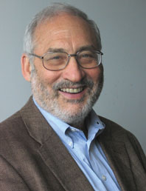
Joseph E. Stiglitz
Basic Facts / Biography
Born 1943 – Gary, Indiana
University Professor, Columbia University (also taught at MIT, Yale, Stanford)
Nobel Prize in Economics (2001; 2007)
Chairman Council of Economic Advisors – Clinton administration (1993-97; chair from 1995)
Responsible for promoting “Third Way”… idea that governments have an important, if limited, role to play in market economies
Chief Economist of the World Bank (1997-2000)
Stormy tenure due to Treasury / IMF reaction to data on poor performance of post-communist countries in previous ten years
Anti-Austerity advocate / Globalization critic
Advisor to Greek government (2010); called European austerity plans a “suicide pact” (2012)
Best-selling author and columnist for the New York Times (“The Great Divide”) and has written for Vanity Fair, Politico, The Atlantic, and Harper's.

Slide 3
Stiglitz: Work and Ideas
Professionally – best known for his work on ‘Information Assymetry’ and as founder of a branch of economics known as the ‘economics of information’
Popularly – best known primarily for his writings on two topics: Globalization and Inequality.
Author of c. 300 articles and a dozen books, including a number of NYT bestsellers. The remainder of this talk will focus on three of these…
Overall, according to IDEAS (largest bibliographic database devoted to Economics), he is the third most frequently cited Economist.

Slide 4
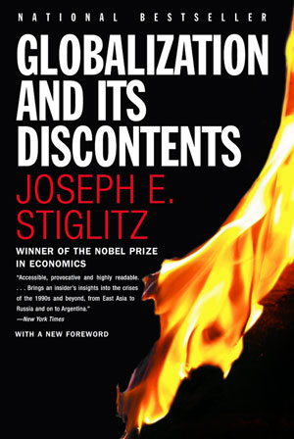
Work on Globalization
Published in 2002, GD was Stiglitz’s first bestselling work directed at a mass audience
Drew on his experience as Chief Economist at the World Bank
Aimed to show both the promise and, especially, the perils (as implemented) of the move toward globalization
Saw strict adherence to World Bank / IMF / Treasury targets as unrealistic and counter-productive
As practiced, policies likely to lead to greater unemployment, lower economic development , and significant social disruption
Argues that what are called "developing economies" are, in fact, not developing at all, and puts much of the blame on the IMF
See also: Making Globalization Work (2006)

Slide 5
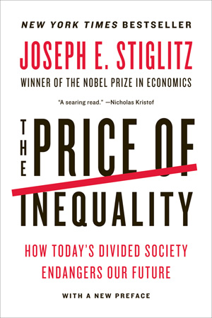

Work on Economic Inequality
2012/13
2015
Notes:
Following crash / great recession, Stiglitz’s concerns turned toward the widening gaps between the have’s and the have-not’s in US society. Inequality broadly defined… income vs. wealth.

Slide 6
Understanding Inequality
In addressing the topic of economic inequality in the United States, Stiglitz focuses on three main issues:
State of inequality in US
Main causes / sources
Consequences

Slide 7
Economic Inequality in the US: Current State
Both in terms of income and overall wealth, economic inequality has grown dramatically in the United States over the past 30 years. This growth has been exacerbated following the 2008 crash and recession that followed. It is now a defining feature of the US economy.
As Stiglitz summarizes, this can be shown by a number of factors:
Relative inequality in US vs other advanced economies
Growth/Percent of income going to top earners
Overall distribution of wealth in society

Slide 8
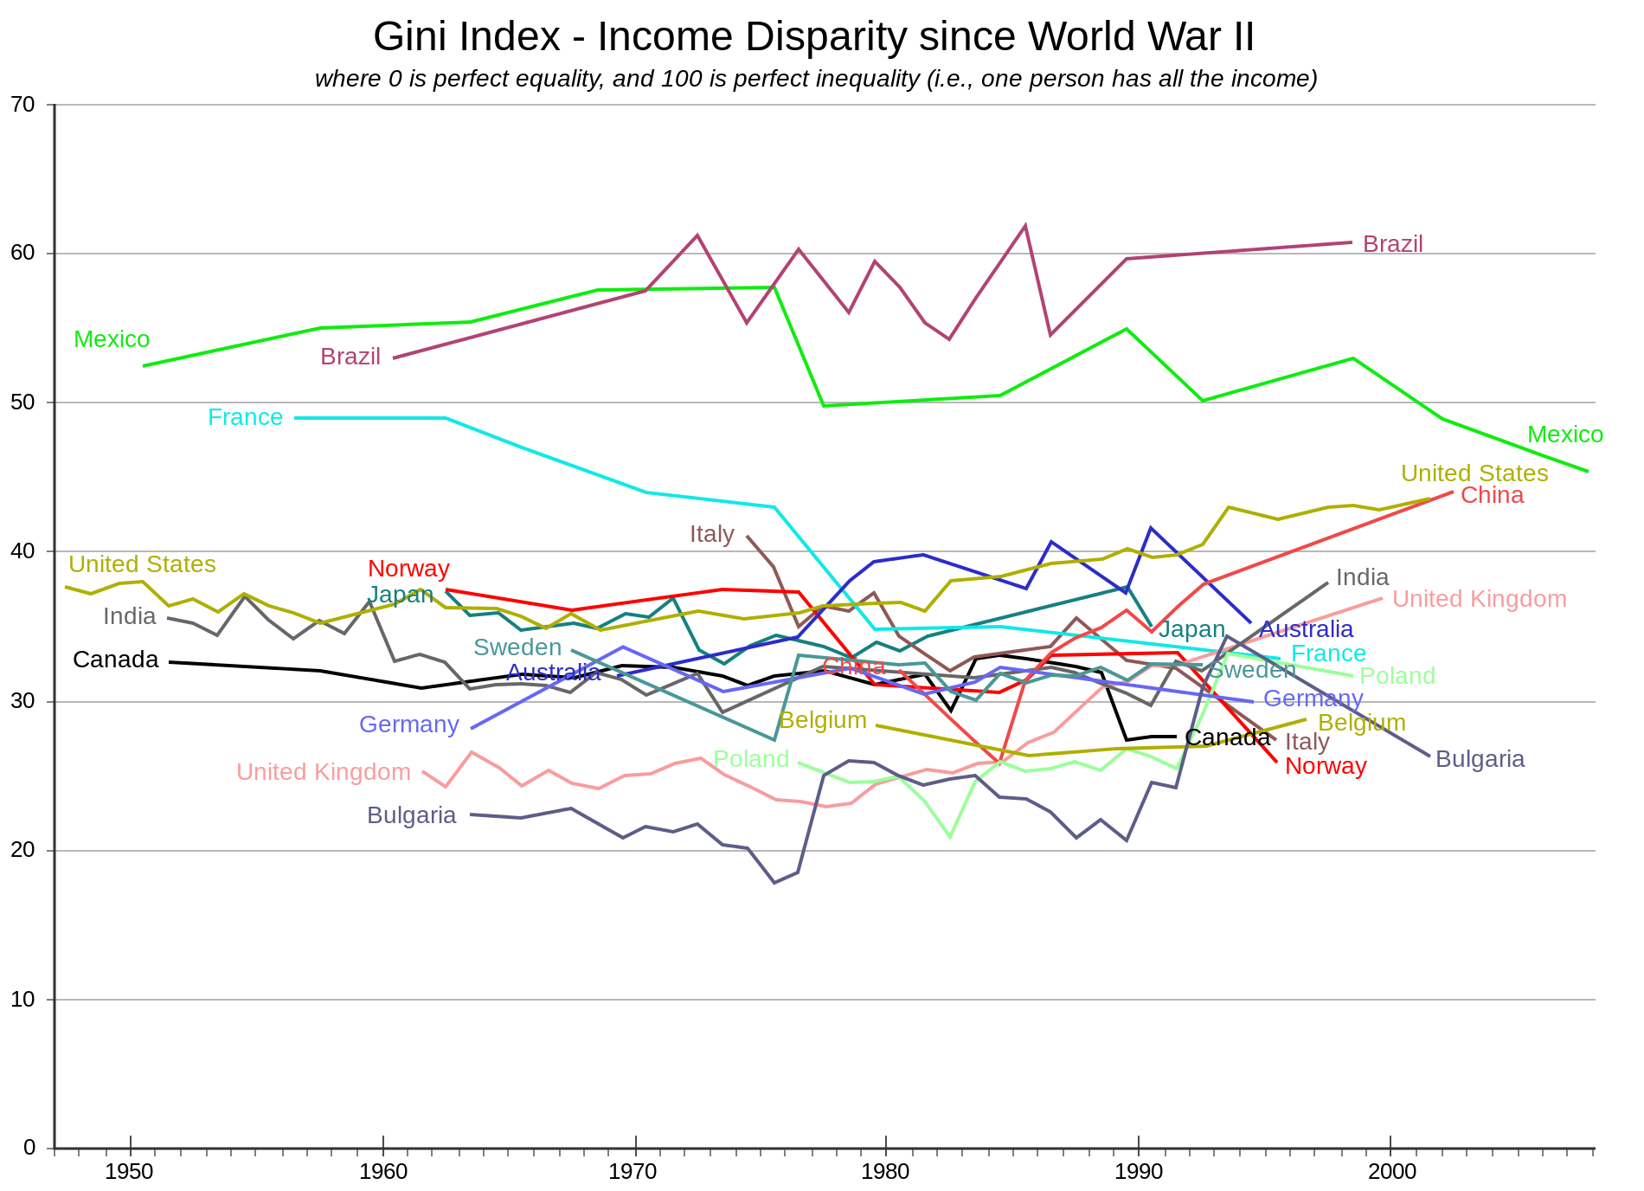
Notes:
Gini up 23% since 1968

Slide 9
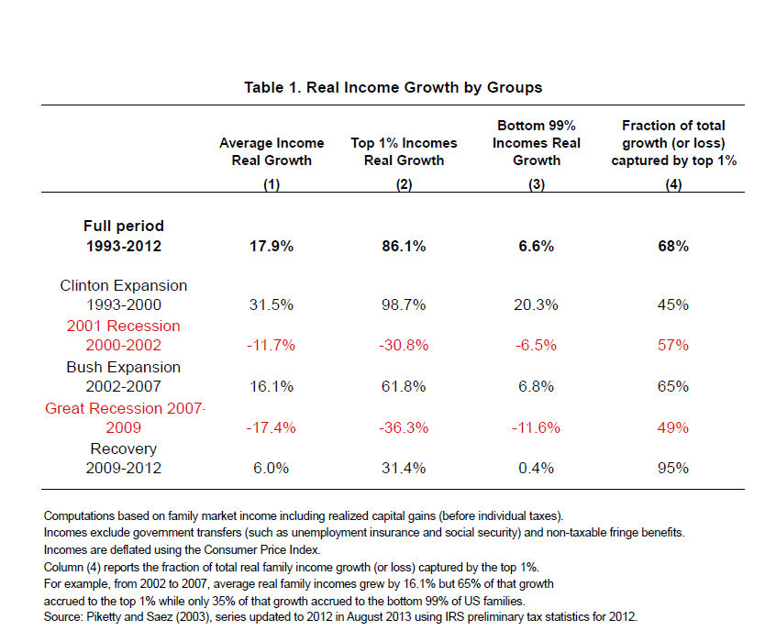
Notes:
Globally, 1% takes in on average 9x bottom 10% combined; In US, the figure is 14x.

Slide 10
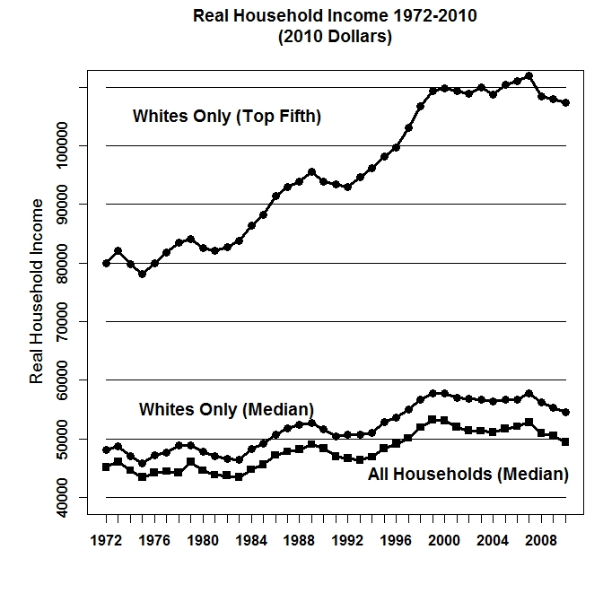
Figure 5.2 Median Household Income and Average Income of Top Quintile 1972 to 2010 (in 2010 Dollars). Income never recovered to the level it reached at the end of the twentieth century under President Clinton. During the eight years of the Bush presidency (2001-08) it recovered somewhat but then fell sharply during the first two years of the Obama presidency. Source: U.S. Census Bureau, Current Population Survey, Annual Social and Economic Supplements.

Slide 11
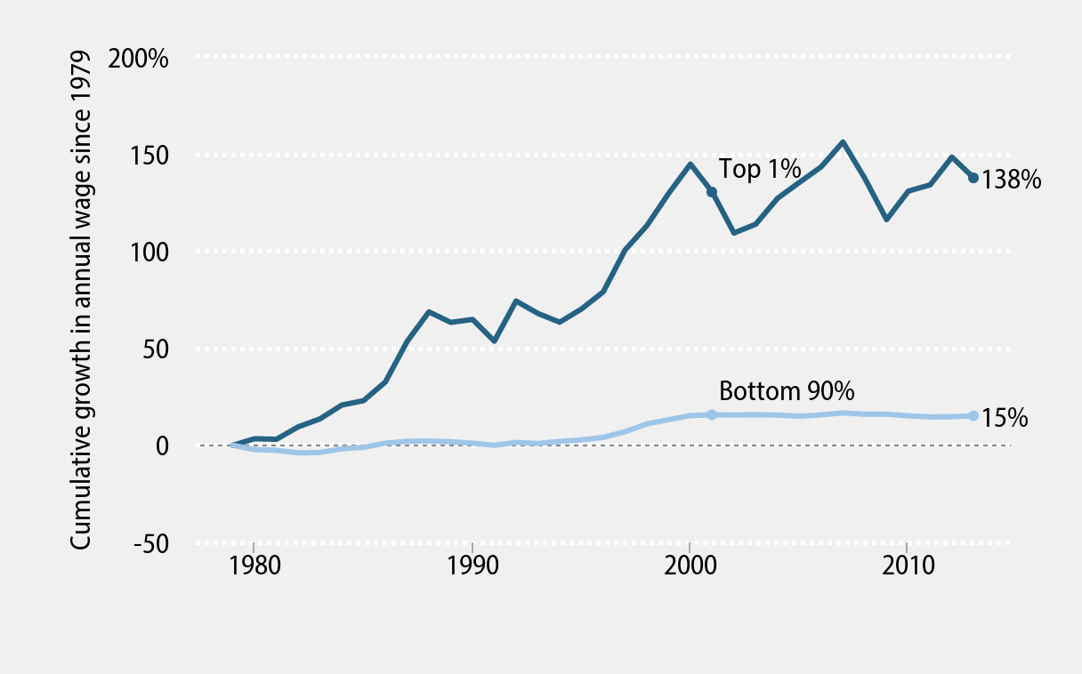
Growth in Wages
Notes:
Source: Economic Policy institute

Slide 12
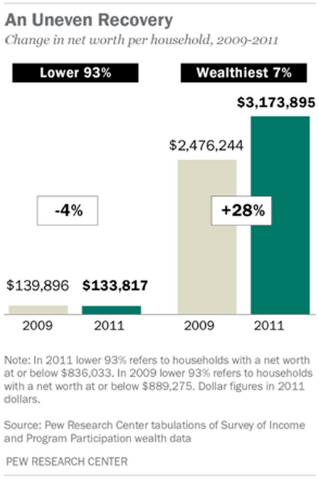
PEW Research: 2013
Notes:
This makes it even worse. (net worth here includes houses).

Slide 13
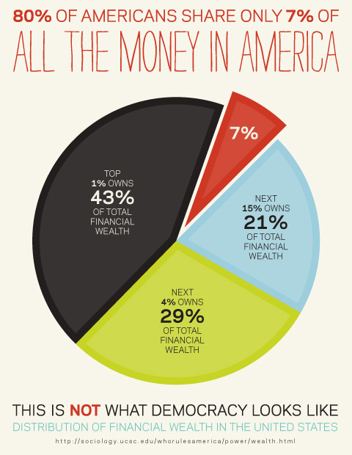

Slide 14
Economic Inequality: Causes
Causes of inequality can be broad, multifaceted, and self-reinforcing. Capitalism itself, Stiglitz claims, is not to blame: Inequality doesn’t come from markets per se, but from markets not functioning as they should. Dysfunction is reinforced by long-standing free market “myths” such as “trickle-down” economics and the “marginal productivity” of top earners.
Additional sources highlighted by Stiglitz (as well as others) include:
Market incentives that favor wealth-generating but non-productive activities, i.e., “rent seeking” behaviors
Government policies, esp. tax structure and corporate governance regs, that favors top earners
Predominance of low wage paying jobs
Increasing education premium

Slide 15
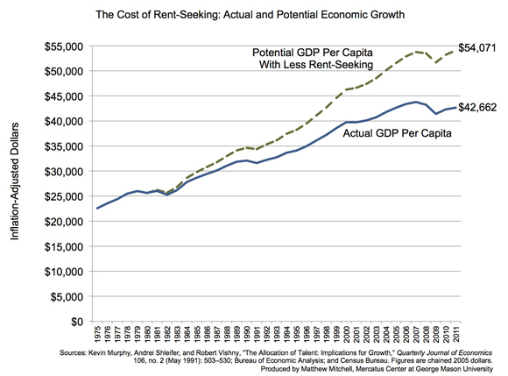
Notes:
Upwards of 40% of corp profits…

Slide 16
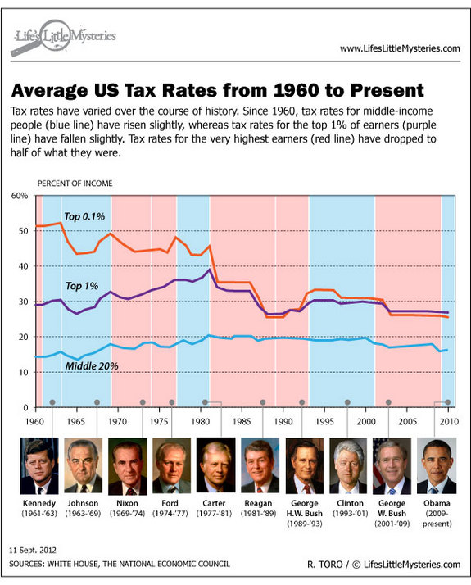

Slide 17
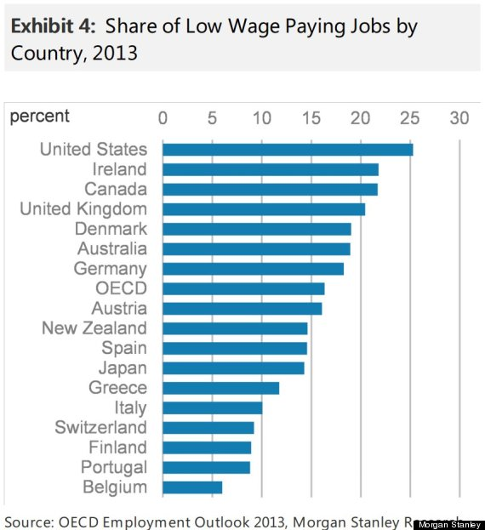
Notes:
Since 2010, 65% of jobs are in lowest sector.

Slide 18
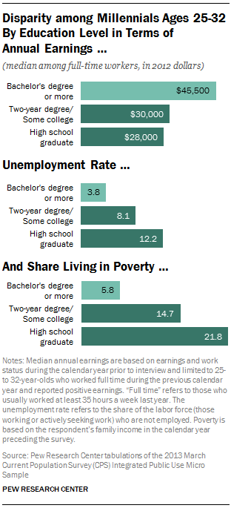

Slide 19
Economic Inequality: Consequences
According to Stiglitz, the consequences of high-level and growing economic inequality are not trivial. Rather, the costs of inequality pervade society as a whole, threatening not only low and middle income earners, but the 1 % as well. Chief among these are:
Underperforming economy -- due in part to downward pressure on consumption, also to ‘systematic underinvestment in commons’ (education, infrastructure, basic research)
Erosion of ‘fairness’ and ‘trust’ on which both markets and democratic process depend
Death of “American Dream” -- lack of opportunity is flip-side of income inequality

Slide 20
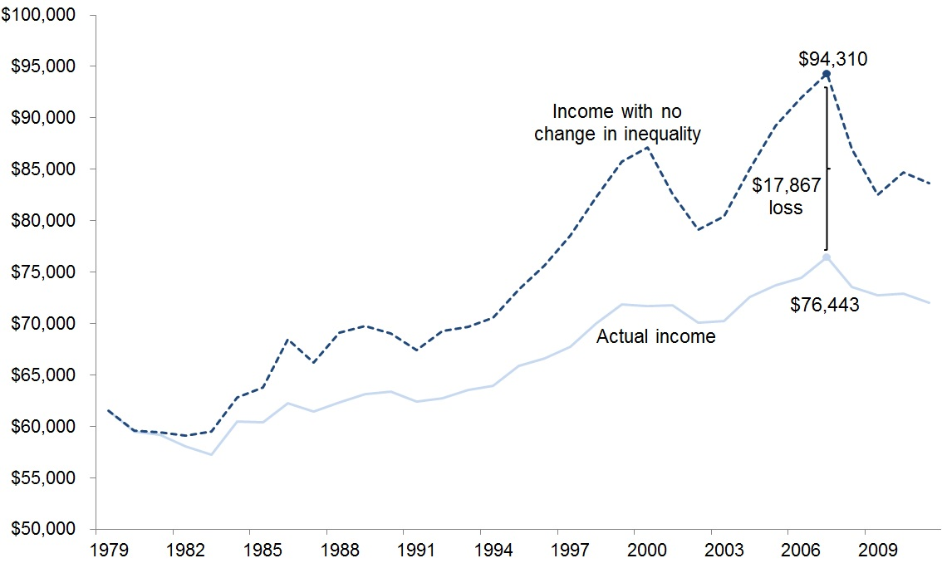
Impact of Inequality on Middle Income Earners

Slide 21
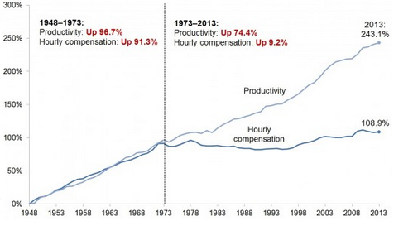
Productivity vs Compensation

Slide 22
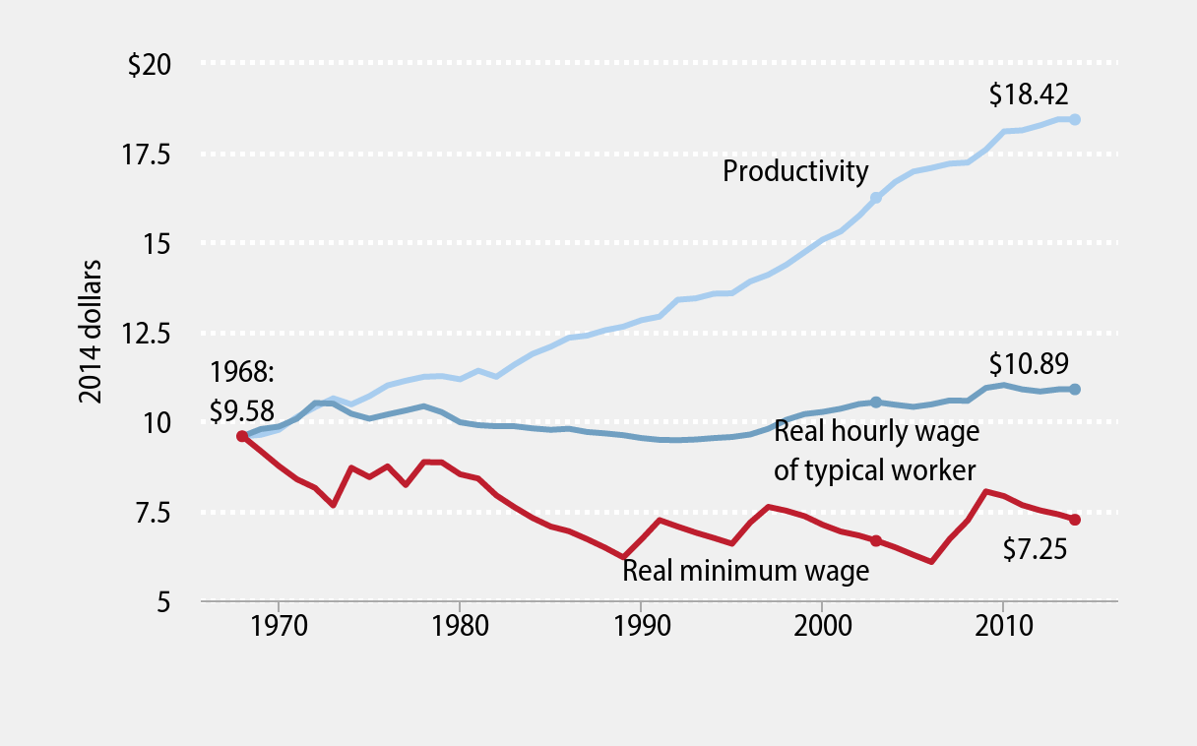
Real Wages vs Productivity Gains

Slide 23
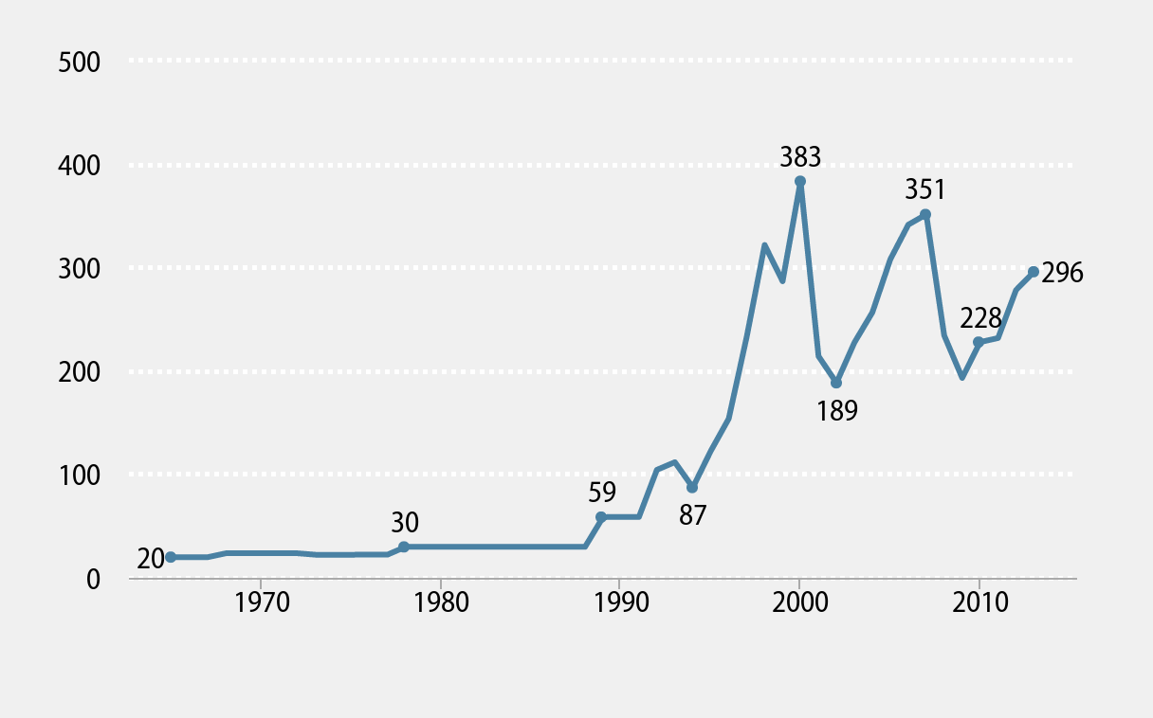
CEO pay vs average worker

Slide 24
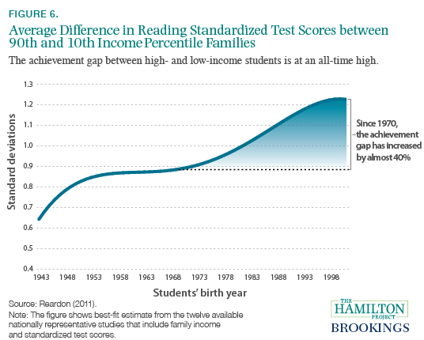

Slide 25
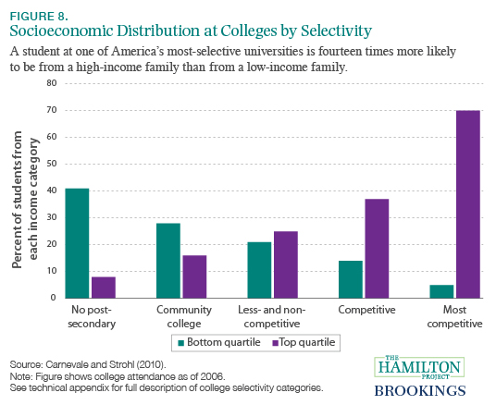

Slide 26
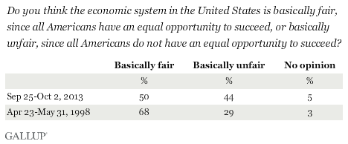

Slide 27
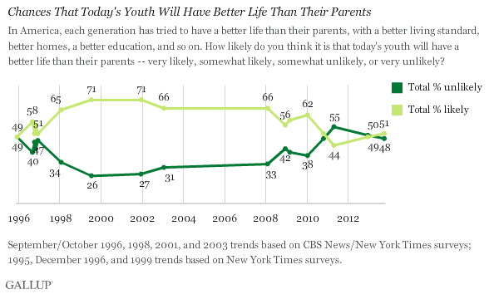

Slide 28
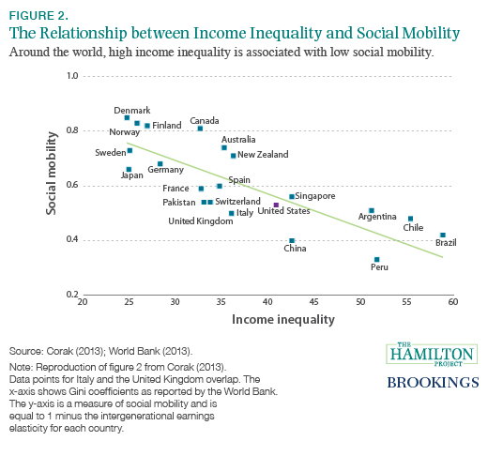

Slide 29
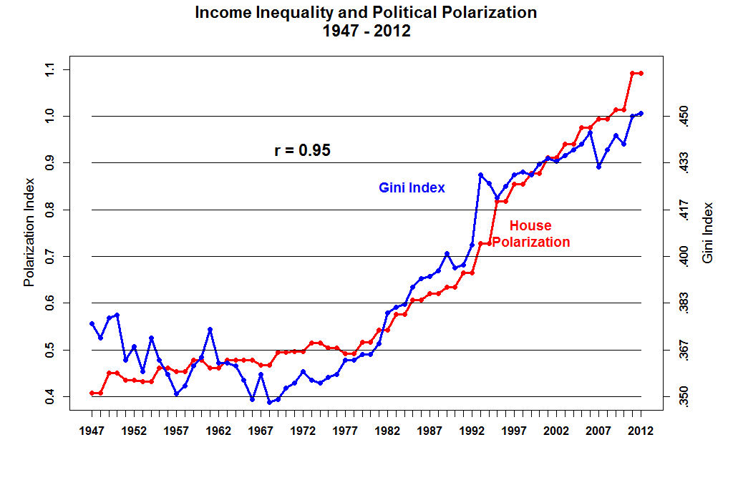
Notes:
Move to consequences

Slide 30
Economic Inequality: Solutions
Stiglitz is quick to suggest that solving the problem of economic inequality in the US is vital not only for the bottom, but the top as well.
Inequality, he stresses, is a choice… not an inborn feature of markets but the result of policies and politics.
What’s needed then…? Public investment, support for labor standards, restoration of bargaining power, revision of tax and regulatory policies, desire to change (among others).

Slide 31
Thank you!
For more information, including sources and citations, please contact:
mlsanders@cazenovia.edu

